Slide 1


NCLEX Mastery Guide
A visual breakdown of exam mechanisms, NGN question prototypes, and scoring schemas.
RN & PN

Slide 2




What is the NCLEX?
The Gateway to Practice
The National Council Licensure Examination is a standardized exam used in the US, Canada, and Australia to determine safety to practice.
NCLEX-RN
For Registered Nurses. Focuses on management of care.
NCLEX-PN
For Practical Nurses. Focuses on coordination of care.

Slide 3


Computerized Adaptive Testing
It Adapts to You
The exam re-estimates your ability after every single question.
Correct Answer? The next question gets Harder.
Incorrect Answer? The next question gets Easier.
PASSING STANDARD
Exam stops when 95% certain. 85 to 150 Questions.

Slide 4






Next Generation NCLEX (NGN)
Measuring Clinical Judgment
Launched in 2023, the NGN format tests your ability to think like a nurse in real-time, moving beyond simple memorization.
It measures the 6 steps of the Clinical Judgment Measurement Model.

Slide 5



Type: Multiple Choice
QUESTION 1 OF 85
A client with heart failure reports sudden shortness of breath. Which action should the nurse take first?
The Standard Item
You choose the one best answer from four options.
SCORING SCHEMA: 0/1 RULE
All or nothing. No partial credit.
Tip: Look for the "Priority" action.

Slide 6


Type: Select All That Apply (SATA)
QUESTION 5 OF 85
Multiple Correct Options
Which foods should the nurse instruct a client taking warfarin to avoid? Select all that apply.
Select all correct options from a list of 5 or 6.
SCORING SCHEMA: +/- SCORING
+1 Point for correct. -1 Point for incorrect. Min 0.

Slide 7




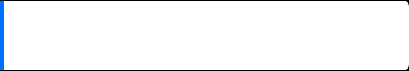



Type: Extended Multiple Response
CASE STUDY: REVIEW
Recognizing Cues
Click to highlight the findings below that require immediate follow-up:
Similar to SATA but allows for more options, often grouped. Used in Case Studies to filter through patient data.
SCORING SCHEMA: +/- SCORING
Get credit for identifying the "abnormal" findings. Lose credit for flagging normal findings as abnormal.

Slide 8







Type: Extended Drag and Drop
CLIENT FINDINGS
OPTIONS
Categorizing & Ordering
URGENT
NON-URGENT
You must move options into specific categories (e.g., Causes vs Symptoms) or into a specific order.
SCORING SCHEMA: 0/1 OR PARTIAL
Points are awarded for placing items in the correct category.

Slide 9
Type: Matrix / Grid
ASSESSMENT FINDINGS
Finding | Expected | Unexpected
Heart Rate 80
Temp 39.5°C
Structured Decision Making
Select one option per row. Used to determine if findings are Expected vs Unexpected.
SCORING SCHEMA: 0/1 RULE (PER ROW)
Each row is graded independently. No penalty for wrong rows (just 0 points).

Slide 10


Type: Cloze (Drop-Down)
NURSES' NOTE
Filling in the Gaps
The client is most likely experiencing as evidenced by the client's .
Requires selecting the correct phrase to complete a sentence, paragraph, or table. It mimics writing a nursing note or an order.
SCORING SCHEMA: 0/1 RULE
You get a point for each correct dropdown selection.

Slide 11
Type: Enhanced Hot Spot
HISTORY & PHYSICAL
Highlight findings consistent with Appendicitis:
Client reports nausea and vomiting. started 2 hours ago. noted. Lungs clear.
Highlighting Evidence
You must click to highlight specific words or phrases in a medical record that represent abnormalities.
SCORING SCHEMA: +/- SCORING
Precise clicking is required. Identifying correct evidence gains points.

Slide 12

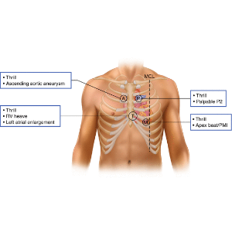
Type: Hot Spot (Image)
ANATOMY ASSESSMENT
Click the location where the nurse should auscultate the Apical Pulse.
Click on the Diagram
You are presented with a diagram or photo (e.g., body part, equipment) and must click specifically on the correct area.
SCORING SCHEMA: 0/1 RULE
Precise placement is key. You must click within the designated acceptable margin to get the point.

Slide 13
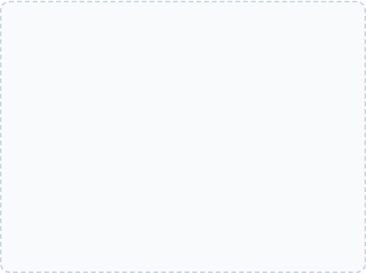

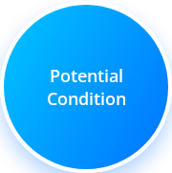

Type: Bowtie
The ultimate NGN item. It connects Action (Left), Condition (Middle), and Outcome (Right).
ACTIONS TO TAKE
PARAMETERS TO MONITOR
SCORING: 0/1 PER CORRECT PLACEMENT
You must correctly match items to the correct side of the bowtie.

Slide 14
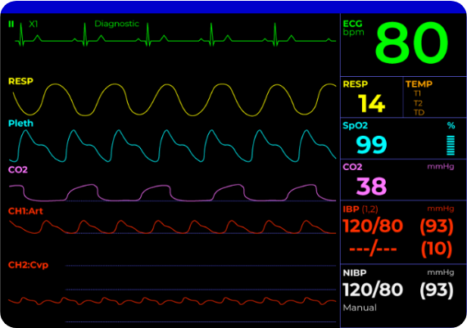

Type: Trend
Identifying Patterns
You are given data over time (e.g., vital signs at 8am, 9am, 10am). You must identify if the patient is improving or declining.
Time | 08:00 | 09:00 | 10:00
BP | 120/80 | 100/60 | 80/50
HR | 80 | 100 | 120

Slide 15


